Slide 1

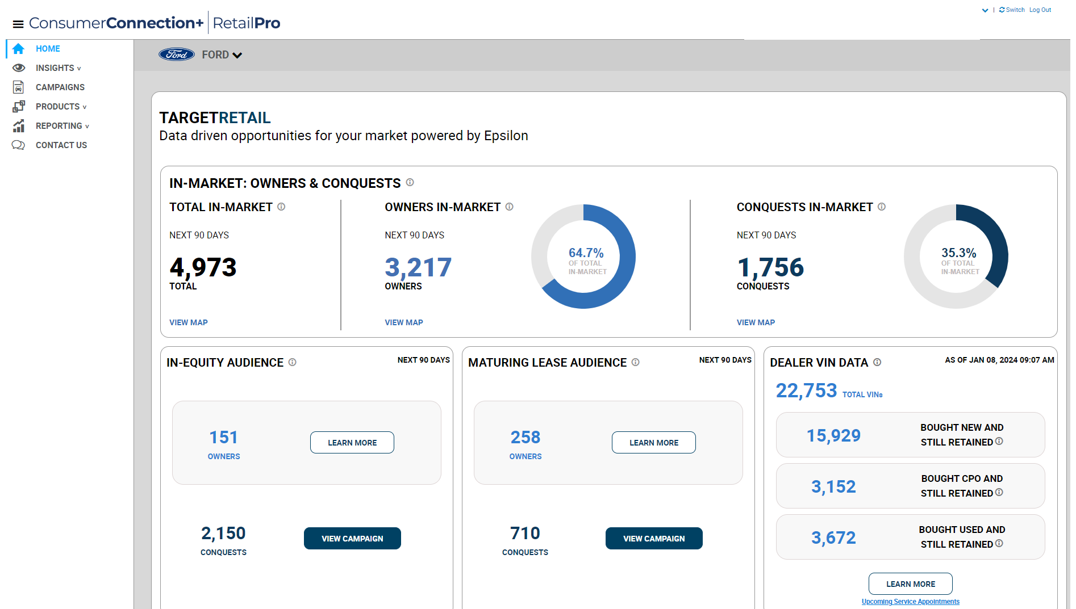

RTM DASHBOARD HAS 4 MAJOR COMPONENTS:
Audience
Insights
Campaign Builder
Reporting

Slide 2
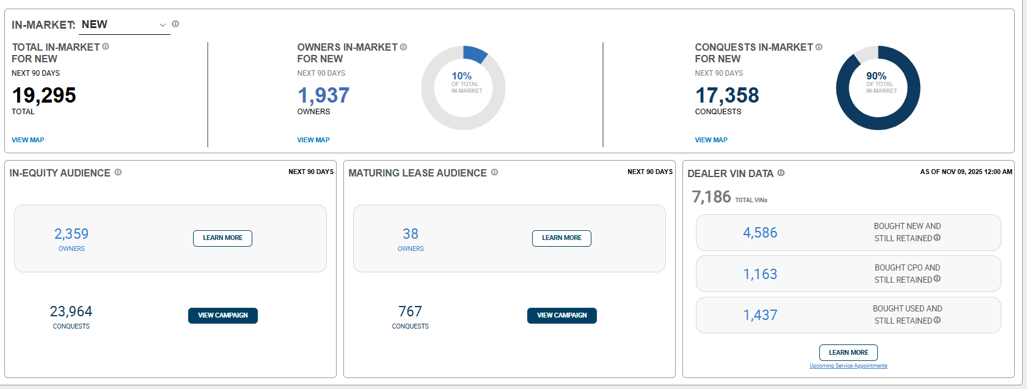
AUDIENCES

Slide 3
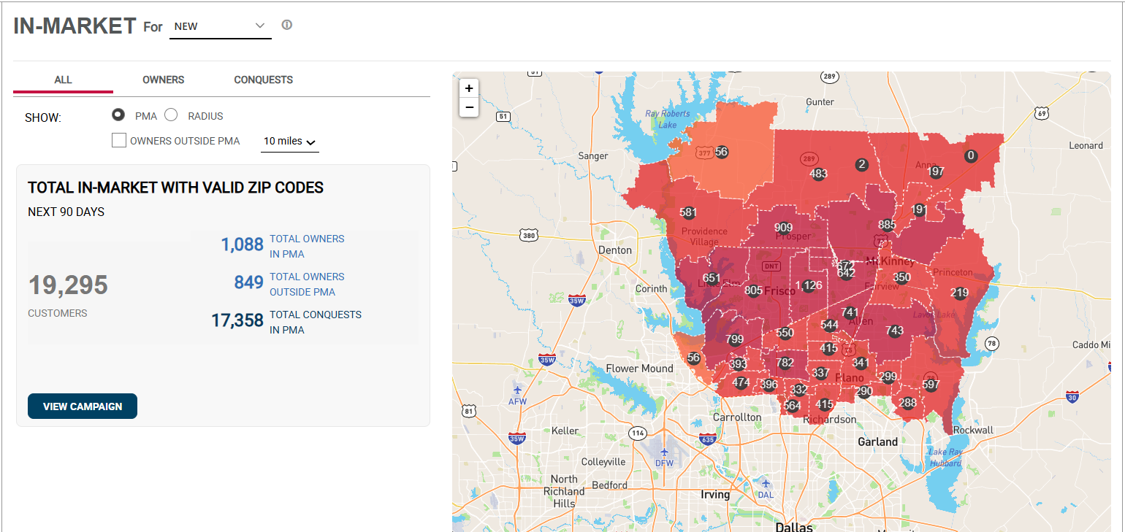
AUDIENCES (MAP)

Slide 4
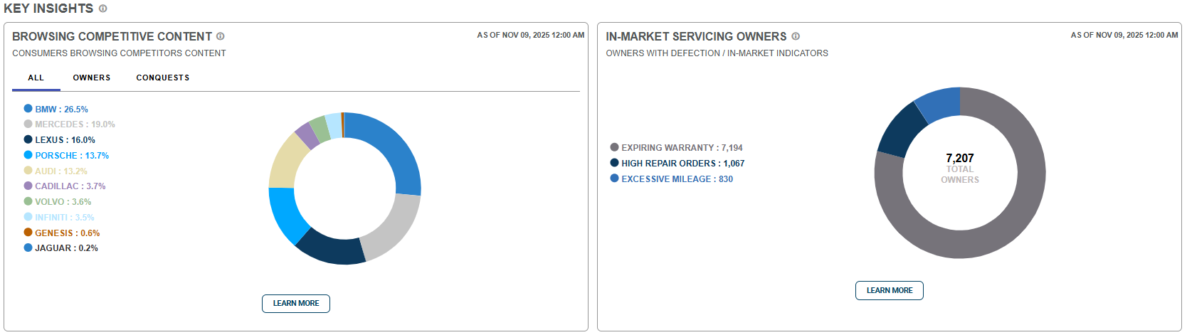
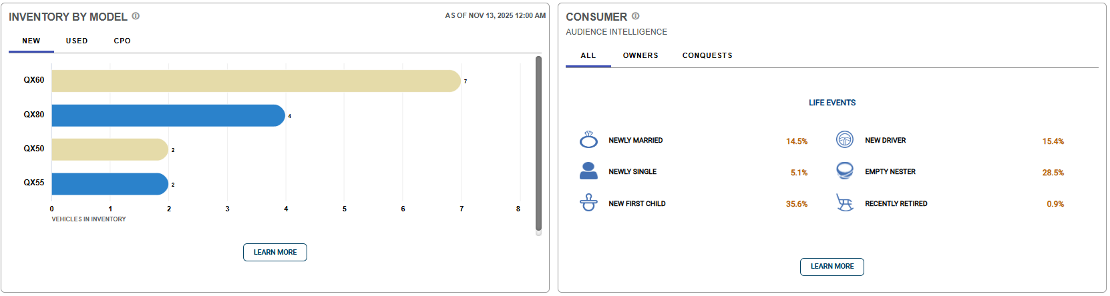
INSIGHTS

Slide 5
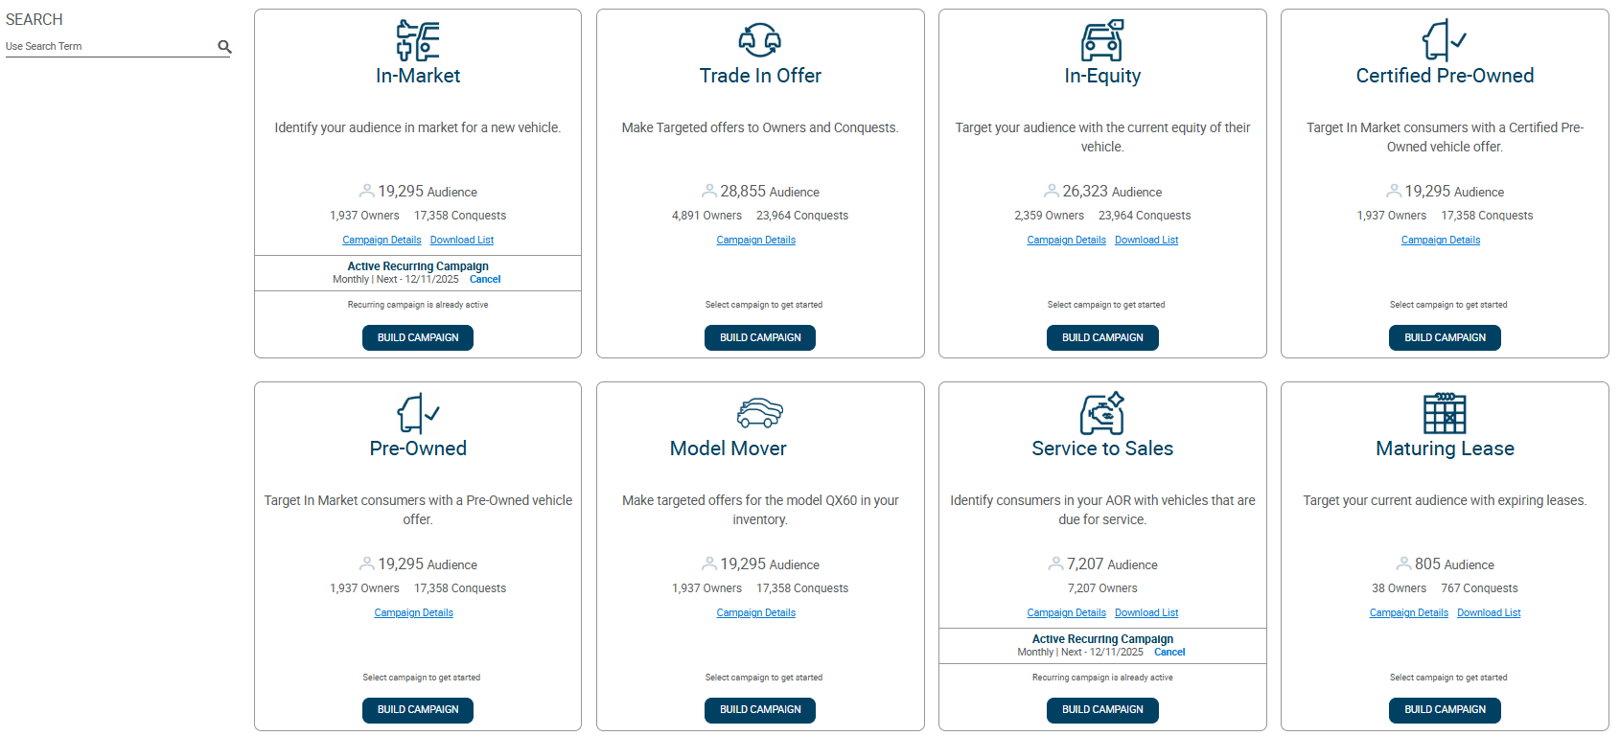
CAMPAIGN LIBRARY/BUILDER

Slide 6
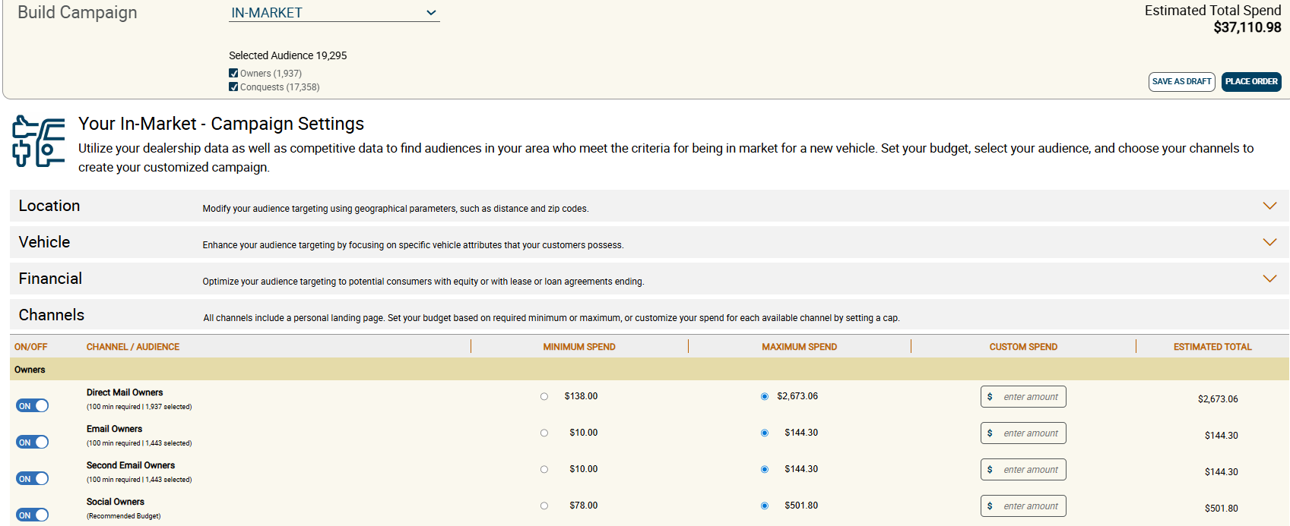
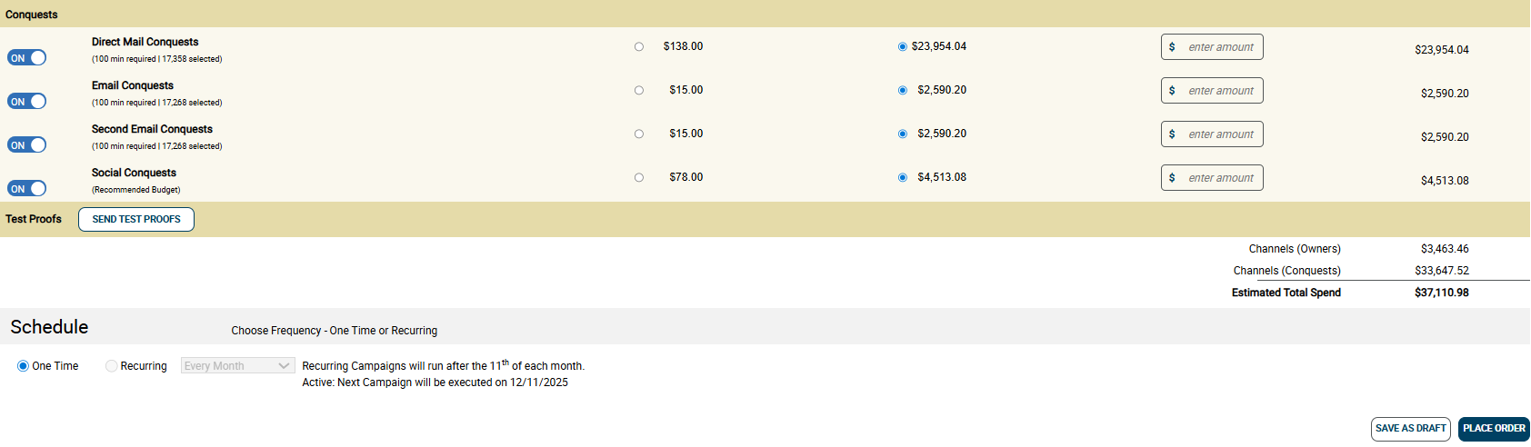
CAMPAIGN LIBRARY/BUILDER

Slide 7
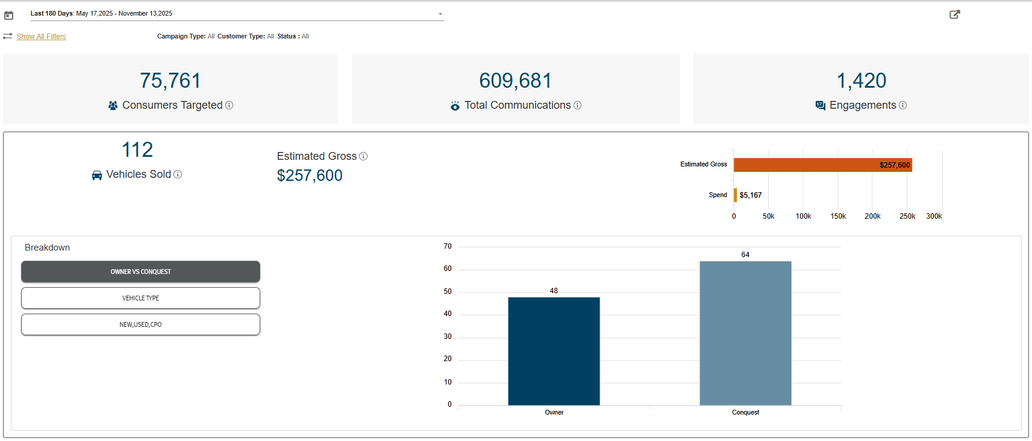
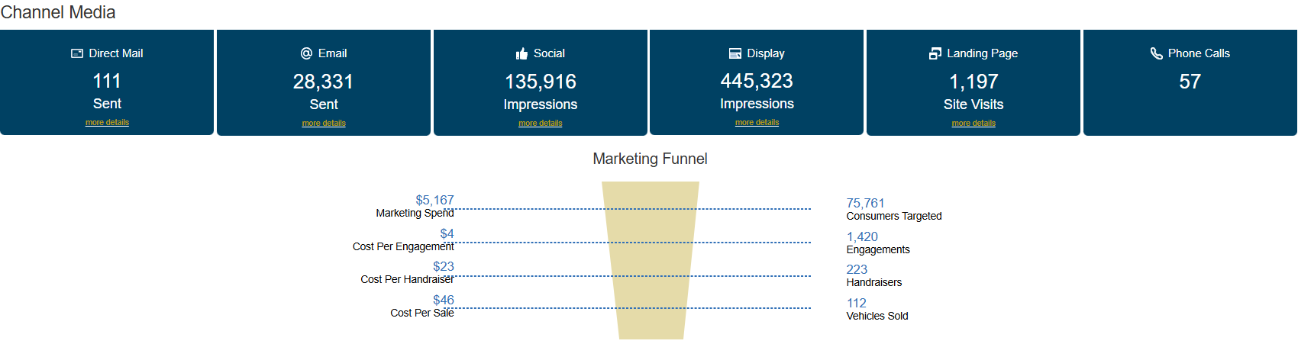
REPORTING

